Slide 1

EditEdit MasterMaster texttext stylesstyles
Practical Lecture : Type conversion

Slide 2

Quick Recap
Let’s take a quick recap of previous lecture –
Basic concept of type conversion
Type conversion- implicit and explicit
Difference between implicit and explicit conversion
Basic type to class type
Class type to basic type
One class to another class type

Slide 3
Today’s Agenda
Today we are going to cover -
Inheritance basics – base class , dervied class
Type of inheritance- simple, multi-level, multiple and hierarchical
Access specifier or mode (private, protected, public inheritance)

Slide 4
C++
Let’s Get Started-

Slide 5
Inheritance basics
Inheritance is one of the object oriented programming paradigm as mentioned initially
Inheritance is the process of using properties of one class into the another class
This is achieved by deriving sub-class from the base class.
A class that is inherited is called a super class,base class or parent class and the derived class is called a sub-class, derived class or child class.
A sub-class is a specialized version of a super class.
Eg. we can categories the ‘animal’ into two categories: ‘wild animal’ and ‘pet animal’. Also we can categories ‘wild animal’ into ‘tiger’, ‘lion’, ‘leopard’ and ‘pet animal’ into ‘cat’, ‘dog’, ‘bull’.

Slide 6
Inheritance basics
It inherits all of the instance variables and methods defined by the super class and add its own, unique elements.
Inheritance provides the facility of re-usability.
We can add new features (new data and function) into existing class without modifying it.
This is done by deriving new class (subclass or child class) from existing class (super class or parent class).
The sub class contains the facility of super class as well as its own features..

Slide 7
Advantages of inheritance
Application development time is less.
Application take less memory.
Application execution time is less.
Redundancy (repetition) of the code is reduced or minimized so that we get consistence results and less storage cost.
Explaination:
Inheritance provides the facility of re-usability. Means Instead of writing the same code, again and again, we can simply inherit the properties of one class into the other. This makes it easier to create and maintain an application. OOP is all about real-world objects and inheritance is a way of representing real-world relationships.

Slide 8
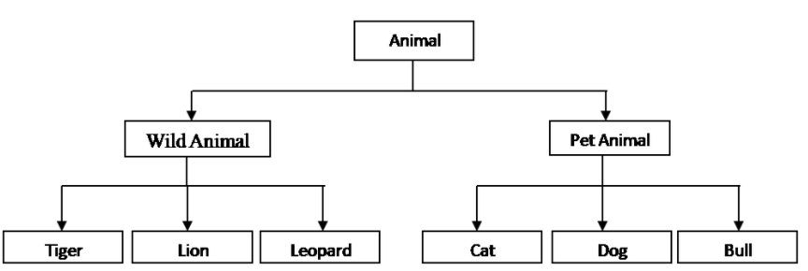
Knowledge check- question
Identify the base class and derived classes in the above figure.
What is ‘Animal’ class called here? What about rest all classes
Type the answers in the chat box.

Slide 9
Knowledge check - Answer
Base class : Animal and derived classes :Wild animal and Pet animal;
Base class : Wild animal , child classes : Tiger, Lion, Leopard;
Base class : Pet Animal , child classes: Cat, Dog, Bull
2. ‘Animal’ class : Base class /super class / Parent class
Wild Animal, Pet Animal: Derived class/ Sub class/ Child class.

Slide 10
Types of inheritance
Single inheritance : This is a form of inheritance in which a class inherits only one parent class.
Multi-level inheritance : In this form of inheritance , a base class is inherited by a derived class, which further becomes base class and inherited by next level derived class and so on
Multiple inheritance : Here a class inherits more than one parent class.
Hierarchical inheritance: In this, various child classes inherit a single Parent class.
Hybrid inheritance: It is the combination of multi-level, multiple and hierarchical inheritance.
Note: <Please encourage students to give various real –life examples of all above classes>

Slide 11
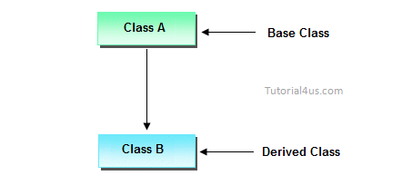
Single Inheritance
Eg. Parent-child, Animal- Dog, Fruit - Apple , doctor- pediatrician

Slide 12
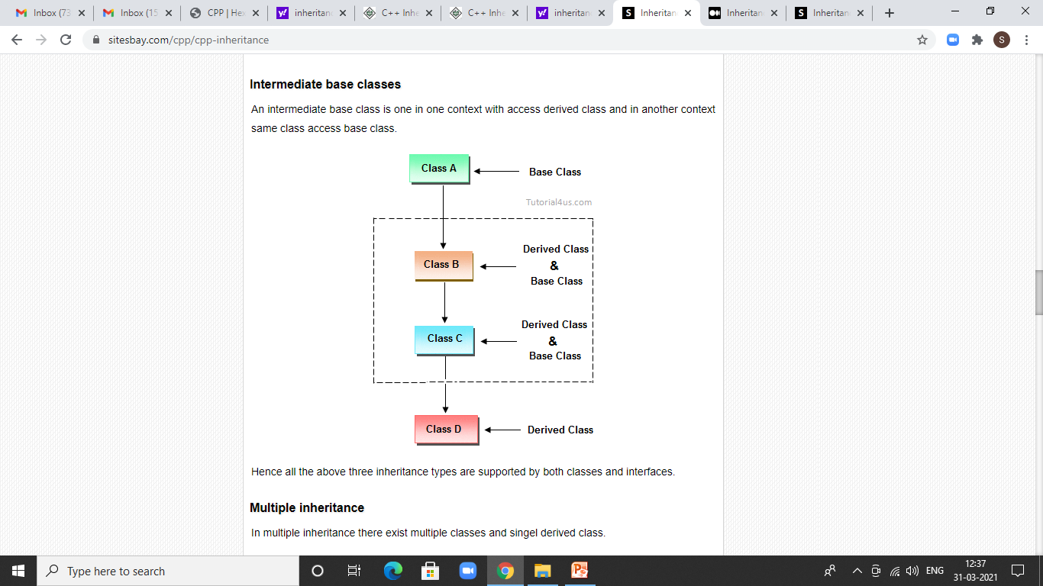
Multi-level Inheritance
Eg. Grandfather- Father- Child, Vehicle-Car- Audi, Doctor- Orthopedic- KneeSurgeon

Slide 13
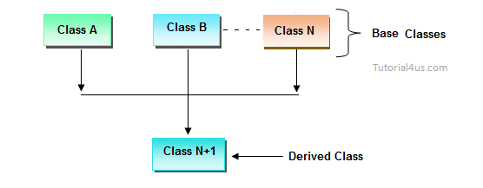
Multiple Inheritance
Eg. Mother, Father- Child , student , Teacher- Teaching Assistant

Slide 14
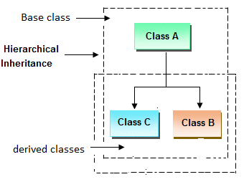
Hierarchical Inheritance
Eg. Animal- Dog, lion, cat etc,
Fruit- Apple, Mango etc,
Person- student ,Teacher, scientist, Engineer etc

Slide 15
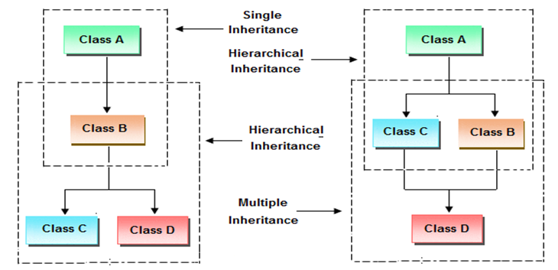
Hybrid Inheritance
Eg:Person- student ,Teacher – Teaching Assistant

Slide 16
Syntax of class derivation
class BaseClass{
// members....
// member function
}
class DerivedClass : public BaseClass{
// members....
// member function
}

Slide 17
Syntax of class derivation
A class can be derived from more than one classes, which means it can inherit data and functions from multiple base classes.
To define a derived class, we use a class derivation list to specify the base class(es).
A class derivation list names one or more base classes and has the form −
class derived-class: access-specifier base-class
Where access-specifier is one of public, protected, or private, and base-class is the name of a previously defined class.
If the access-specifier is not used, then it is private by default.

Slide 18
Practice Question
Define a class student and a derived class test which stores marks of subject 1 and subject 2.
class student
{
int roll_number;
public:
void get_number(int);
void put_number(void);
};
void student::get_number(int a)
{
roll_number=a;
}
void student::put_number()
{
cout<<"Roll number= " <<roll_number<<endl;
}

Slide 19
Practice Question
class test:public student
{
float sub1;
float sub2;
public:
void get_marks(float,float);
void put_marks(void);
};
void test::get_marks(float x,float y)
{
sub1=x;
sub2=y;
}

Slide 20
Practice Question
void test::put_marks()
{
cout<<"Marks in sub1="<<sub1<<endl;
cout<<"Marks in sub2="<<sub2<<endl;
}
int main()
{
test t1;
t1.get_number(11);
t1.put_number();
t1.get_marks(75.0,59.5);
t1.put_marks();
return 0;
}

Slide 21
Practice Question
Output:
Roll number= 11 Marks in sub1=75 Marks in sub2=59.5

Slide 22
Assignment
Create a class Employee which stores and displays attributes of an employee like empname, empno, department, salary. Create a derived class called Project which allows to store project name. Write a C++ program to create object of project class.

Slide 23

QNA Time
Any Questions??
Any Questions ??

Slide 24
Thank You!
See you guys in next class.

